Slide 1
Eastern Gray Squirrel
(Sciurus carolinensis)
By Analytical Behaviorism

Slide 2
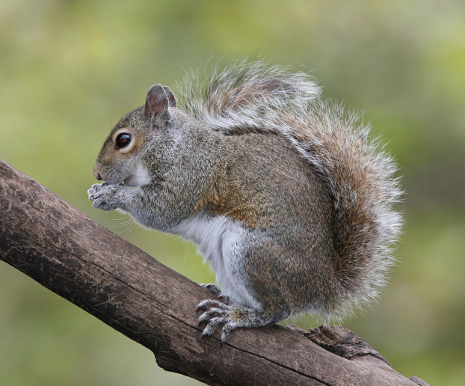
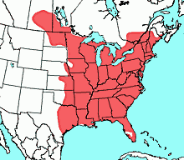
Eastern Grey Squirrel Background
Scientific Name: Sciurus Carolinensis
Life span: 6 years
Habitat and Range: Eastern Hardwood forest in the USA and Canada, recently introduced to England and South Africa
Appearance:
Commonly in 2 color phases, Black and Grey
Usually has a white underside
Most notable for its large, bushy tail
Behaviors:
Spends majority of its life in trees
Has great agility, using its tail to balance and leap from branch to branch
Most active during the day, does not hibernate
Known foragers, primarily eats nuts and is known to bury them without returning to the place where they buried them, causes trees to grow
Notes:
Aidan reads

Slide 3
Our five hypothesis
Hypothesis 1: Squirrels use sound cues during foraging as a way to determine if danger is nearby without losing focus or finding food.
Hypothesis 2: Squirrels use a variety of noises and movements to warn other squirrels of a threat that is within the area.
Hypothesis 3: Squirrels use sounds made from other animals to determine whether an area is safe to move to.
Hypothesis 4: Squirrels listen for possible sounds that could be made by humans to ensure if the environment is safe.
Hypothesis 5: Squirrels use sounds made from nature (wind, rain falling, etc.) to determine whether it is safe to go foraging on that given day.
Notes:
Kasey reads

Slide 4
Deep Lab Cut Data

Slide 5
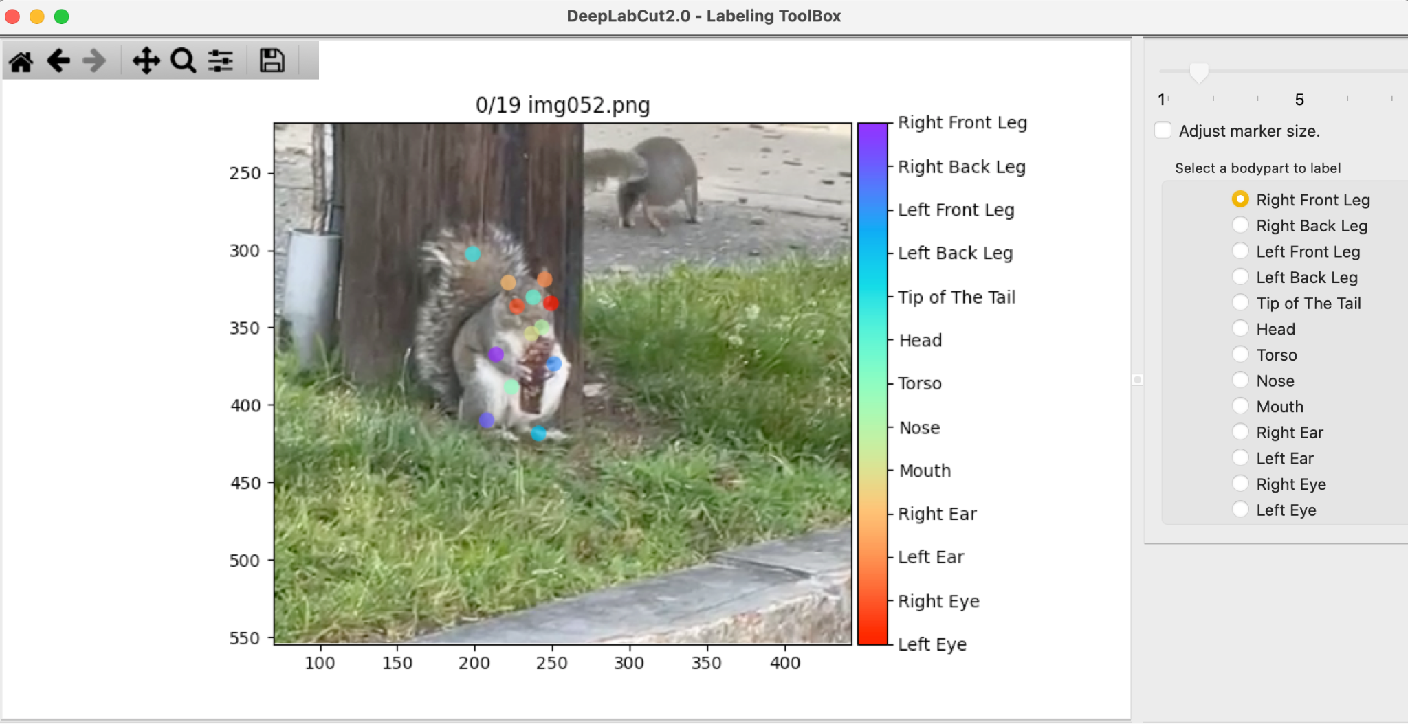
Body parts labelled
Notes:
Vitoria reads
13 body parts;
Precising label - only parts we could clearly see and always on the same spot if possible
For example tail always at

Slide 6
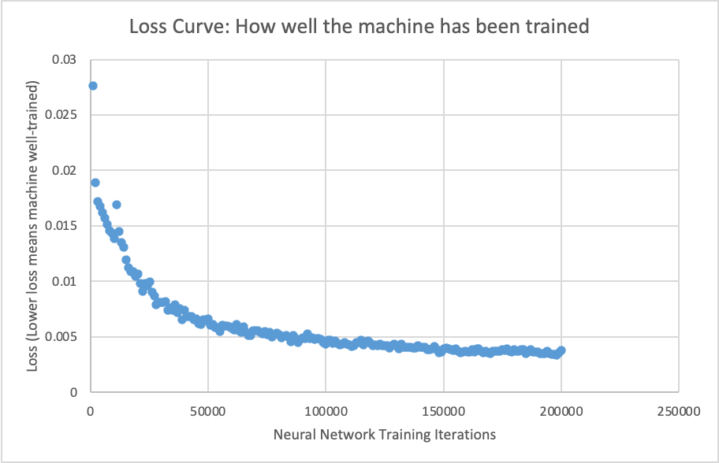
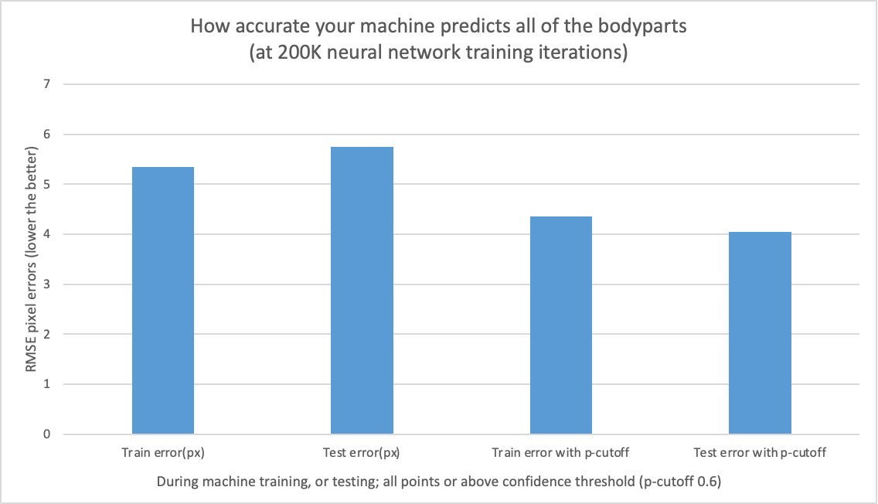
Loss curve
RMSE
Notes:
Vitoria reads
A higher loss means the machine is well-trainedated.
a learning curve is loss over time. Loss (or cost) measures our model error, or “how bad our model is doing”. So, for now, the lower our loss becomes, the better our model performance will be
____________
RMSE stands for Root Mean Square Error, one of the most commonly used measures for evaluating the quality of predictions. It shows how far predictions fall from measured true values using Euclidean distance.

Slide 7
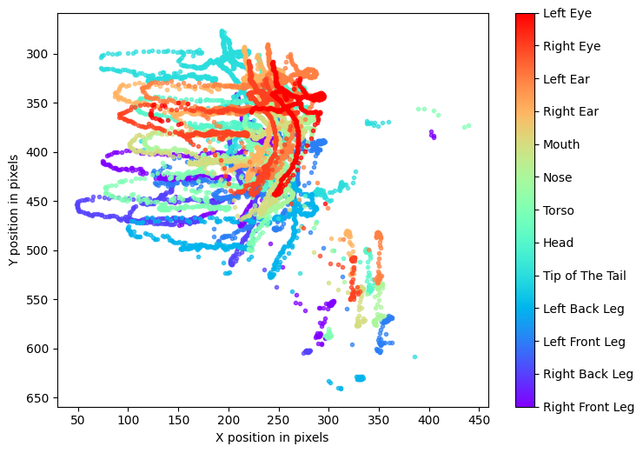
Body parts plotted in space
Notes:
Vitoria reads
Consistent
it has higher overall likelihood, and lower overall deltas
It’s from a video of a squirrel eating a cereal bar - the drop represents when another squirrel approached him and he was defending his bar.

Slide 8
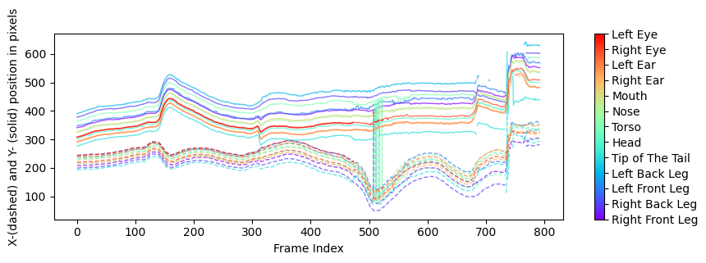
All body parts across time
Notes:
Aidan reads

Slide 9
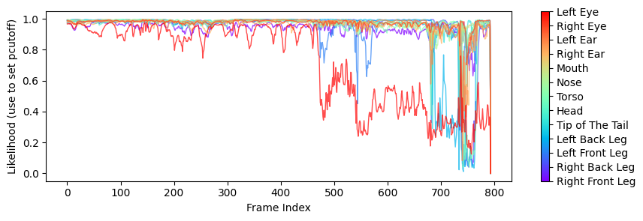
Every body part likelihood over time
Notes:
Aidan reads
Indicates where p cutoff should be set

Slide 10
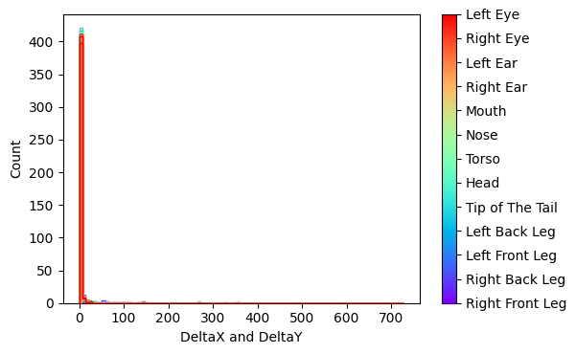
Consecutive Differences
Notes:
Aidan reads
Indicates change in coordinates, we want it to be a straight line
Consecutive means multiple things are happening one after the other, in sequence

Slide 11

Example of video we labelled
Notes:
Vitoria

Slide 12
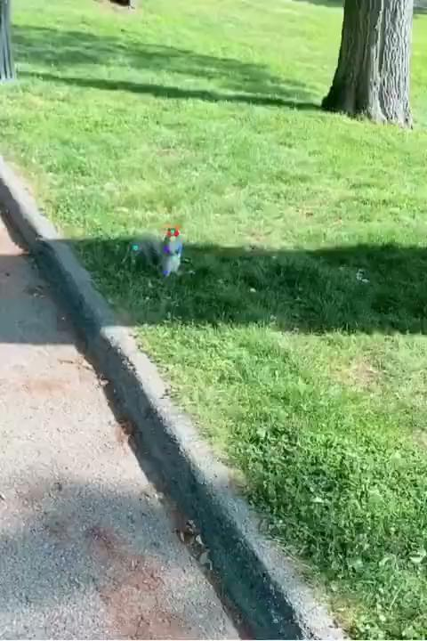
Example of video we labelled
Notes:
Vitoria

Slide 13
Our selected hypothesis
Squirrels use sound cues during foraging as a way to determine if danger is nearby without losing focus or finding food.
With the evidence that was gathered with the videos, this hypothesis seems the most plausible with the data we received
Notes:
Tydina reads

Slide 14
Hypothesis support
When presented with noises that are deemed threatening to the squirrel, it will display behaviors of fleeing because of the perceived threat.
Whenever a subject approached a squirrel and made noise, it immediately stopped foraging behaviors and performed defensive behaviors.
Variables that may affect the outcome...
Other external factors such as other perceived threats may have made the squirrel flee
Human error: Subject may not have created enough disturbance for the squirrel to notice

Slide 15
Our research design

Slide 16
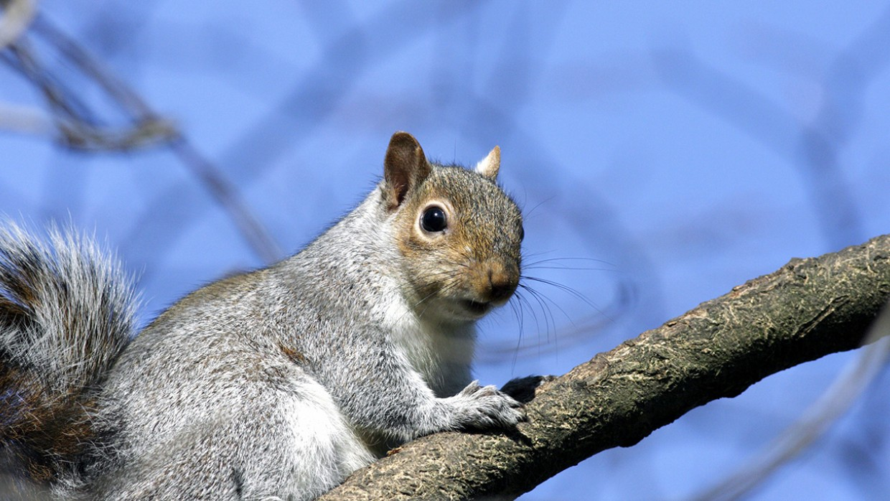
Design
Quasi experimental study, no control, observing and recording the squirrels to see their behaviors in their natural environment;
Recorder would slowly walk towards the squirrel to see its reaction to the natural noises / disturbances during approach;
Focus on the squirrels behaviors and actions:
Is it turned towards the recorder?
Does it acknowledge the recorder?
Does it seem defensive when approached?
Did it run away from the recorder or was there another external force?
Notes:
Romario reads

Slide 17

How did it work?
Doing the quasi-experiment helped in providing a high level of evidence without randomisation;
We recorded the Eastern Gray Squirrel spontaneously in the wild, both in urban and suburban settings - We did not interfere with the animals or their natural environment;
We recorder Squirrels by themselves, interacting among themselves and interacting with other humans;
as similar as they are to each other, Deep Lab Cut allowed for comparison, tracking movements, and powering our hypothesis;
Notes:
Romario reads

Slide 18
Research ethics associated with our research design

Slide 19
"Squirrels use sound cues during foraging to determine if danger is nearby without losing focus or finding food"
We couldn't manipulate our animals and place them in a controlled environment.
Due to the lack of data there was a reliability issues because we only submitted 30 videos to support our hypothesis.
One issue we encountered as a team was the inability to upload videos that were not our own to support our hypothesis.
Some of the demographic risks include squirrels being dangerous, and the animals not being in their natural habitat
Any interaction with the animal that may cause them to change their usual behavior requires full ethical approval from the IACUC (institutional animal care and use committee).
In terms of culture and values that needed to be considered; we focused on the freedom for the animals, in regard to how the animal exist and made sure to not apply any danger and harm to them.
If we were to publish our research it wouldn't be plagiarized due to the fact all of the videos were ours and nothing was taken from somewhere else.
Notes:
Sumaya reads
Based on our understanding on chapter 3 of ethics, we couldn't manipulate our animals and place them in a controlled environment. Due to the lack of data there was a reliability issues because we only submitted 30 videos to support our hypothesis.
It would have been a stronger case if we had more opportunity and access to observe squirrels in their natural habitat in terms of sounds. One issue we encountered as a team was the inability to upload videos that were not our own to support our hypothesis.
Throughout the investigation some of the demographic risks include squirrels being dangerous, and the animals not being in their natural habitat, which would be beneficial to us conducting the experiment. Any interaction with the animal that may cause them to change their usual behavior requires full ethical approval from the IACUC (institutional animal care and use committee). In order to protect not only the animals but also ourselves as researchers. In terms of culture and values that need to be considered; we focused on the freedom for the animals, in regard to how the animal exist and made sure to not apply any danger and harm to them. If we were to publish our research it wouldn't be plagiarized due to the fact all of the videos were ours and nothing was taken from somewhere else.
___________________________________________ dont read bellow
For each of the players you thought of above, think about the ethical issues that you need to consider, and
possible procedures you would follow. Some questions could include:
a. What are the risks for these players?
b. What bias are present?
c. What sort of continuous and meaningful consent is needed?
d. What cultures and values are at play that needs to be considered in ethics?
e. Will they need to experience pain, discomfort, stress, sickness, and death?
f. Is this research conducted using methods or land that have historically marginalised or oppressed
certain communities?
g. What committees do you need approval from?
h. How do you prevent plagiarism should you publish this research?

Slide 20
References
Chow, K. Y., Clayton, N., & Steele, M. (2021, February 26). Cognitive Performance of Wild Eastern Gray Squirrels (Sciurus carolinensis) in Rural and Urban, Native, and Non-native Environments (S. Ducatez, Ed.) [Review of Cognitive Performance of Wild Eastern Gray Squirrels (Sciurus carolinensis) in Rural and Urban, Native, and Non-native Environments]. Frontiers in Ecology and Evolution; Frontiers. https://www.frontiersin.org/articles/10.3389/fevo.2021.615899/full#h6
Cronk, L., & Palombit, R. (2021). Eastern gray squirrel (Sciurus carolinensis) color morphs do not differ in aggressiveness. Acta Ethologica, 24(3), 143–147. https://doi.org/10.1007/s10211-021-00372-z
E.G.Lea, S., A.Leaver, L., Wauters, L. A., Steele, M. A., Pravosudov, V. V., Partan, S. R., Murphy, D., Makowska, I. J., Lima, S., Lima, S. L., Kroodsma, D. E., Heyes, C. M., Gerber, L., Galef, B. G., Frommolt, K. H., Fisler, G. F., Ekman, J., Bednekoff, P. A., Allen, D., … Gurnell, J. (2015, May 6). Behavioural responses of eastern grey squirrels, sciurus carolinensis, to cues of risk while foraging. Behavioural Processes. Retrieved December 6, 2022, from https://www.sciencedirect.com/science/article/abs/pii/S0376635715001254
Hinterland Who’s Who - Eastern Grey Squirrel. (n.d.). Www.hww.ca. https://www.hww.ca/en/wildlife/mammals/eastern-grey-squirrel.html#sid2
Lilly, M. V., Lucore, E. C., & Tarvin, K. A. (2019). Eavesdropping grey squirrels infer safety from bird chatter. PLOS ONE, 14(9), e0221279. https://doi.org/10.1371/journal.pone.0221279
Simmons, A., & McRae, T. (2014, May 1). Hidden Markov models of eastern gray squirrel (Sciurus carolinensis) alarm calls. SagePub Journals. Retrieved December 6, 2022, from https://journals.sagepub.com/doi/full/10.1177/1059712314529981

Slide 21

Thank you
Aidan McGinnis
Kasey O’Mahony
Romario Joseph
Sumaya Abdullahi
Tydina Muhammad
Vitoria Gomes de Mattos Sousa
PSYCH 201 - Introduction to Behavioral Research
Professor Vic Shao-Chih Chiang
University of Massachusetts Boston
Visit our Grey Squirrel Github:

